Slide 1
1 2 3 4 5 6 7 8 9 10 11 12
The numbers 1-12
naturally form four groups
First Principles: 1, 2
Numbers of Structure: 3, 4, 6, 8, 12
Numbers of Life: 5, 10
Numbers of Mystery: 7, 9, 11
Michael S. Schneider
www.constructingtheuniverse.com

Slide 2
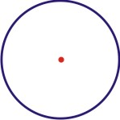
Page 12
1
A practical symbol of:
* Unity, Wholeness, Completeness
* Equality in all directions from the center
* Repeating Cycles
* Containing most inside with the least around
(Read Chapter 1 in ABGTCTU to find out why!)

Slide 3
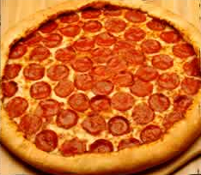
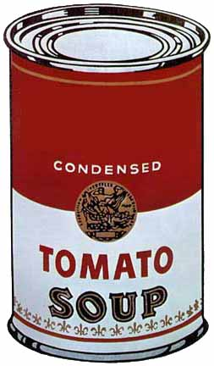
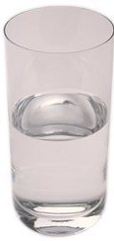
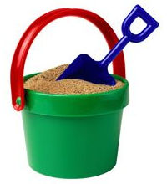
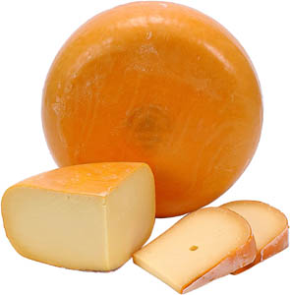
Circle: The shape with
The Most Inside with the Least Around
Page 13
Of all shapes with the same length of crust, round pizzas hold the most toppings.
So if you like toppings, get the round pizza
and not the square, rectangle or triangle
with the same perimeter
Cylinders – Extruded Circles
They hold the most inside
using the same amount of material.
Using the same metal, any other shape of can (except sphere) would hold less soup
(or water, sand or cheese).

Slide 4
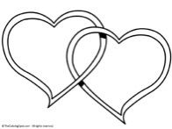
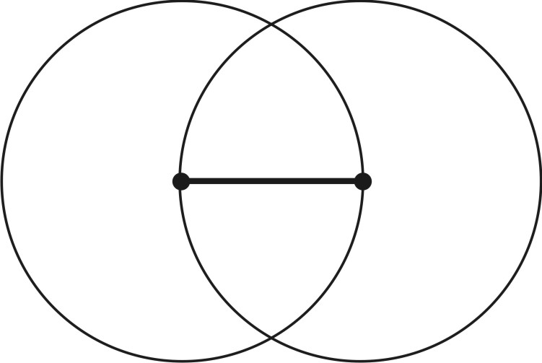

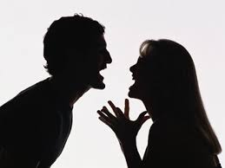
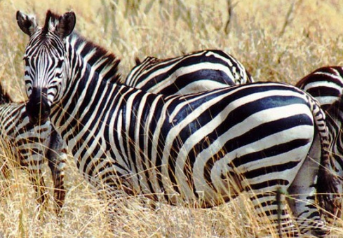

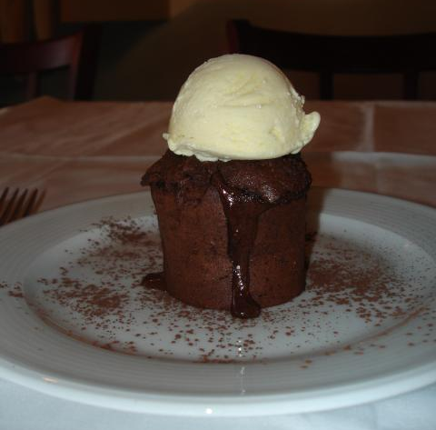
2 --Polarity:
Opposites and Complements
Conflict and Cooperation.
Page 15-16
Everything contains a bit of its own opposite

Slide 5
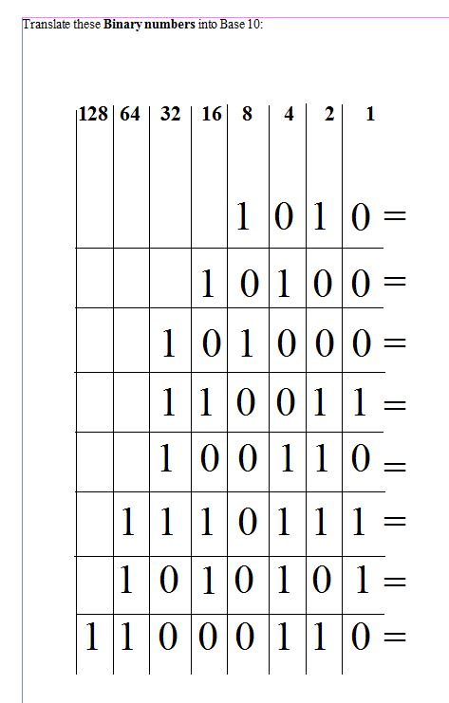
Page 23
Translate these Binary numbers into Base 10:
10
Sliding the digits to the left and adding a 0 will double its value
20
40
51
38
119
85
198

Slide 6
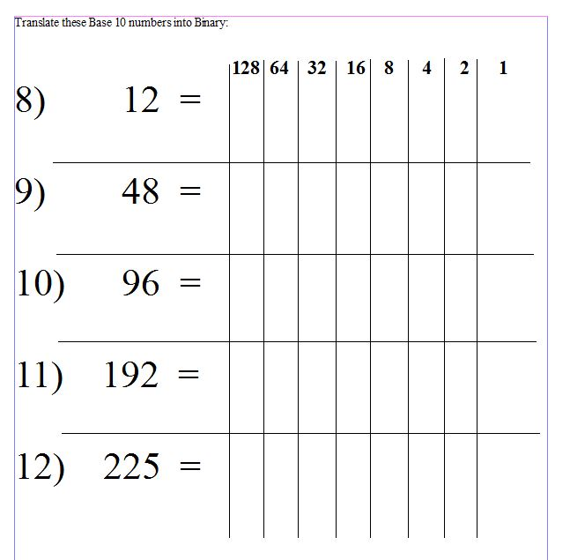
Page 24
1 1 0 0
1 1 0 0 0 0
1 1 0 0 0 0 0
1 1 0 0 0 0 0 0
1 1 1 0 0 0 0 1

Slide 7
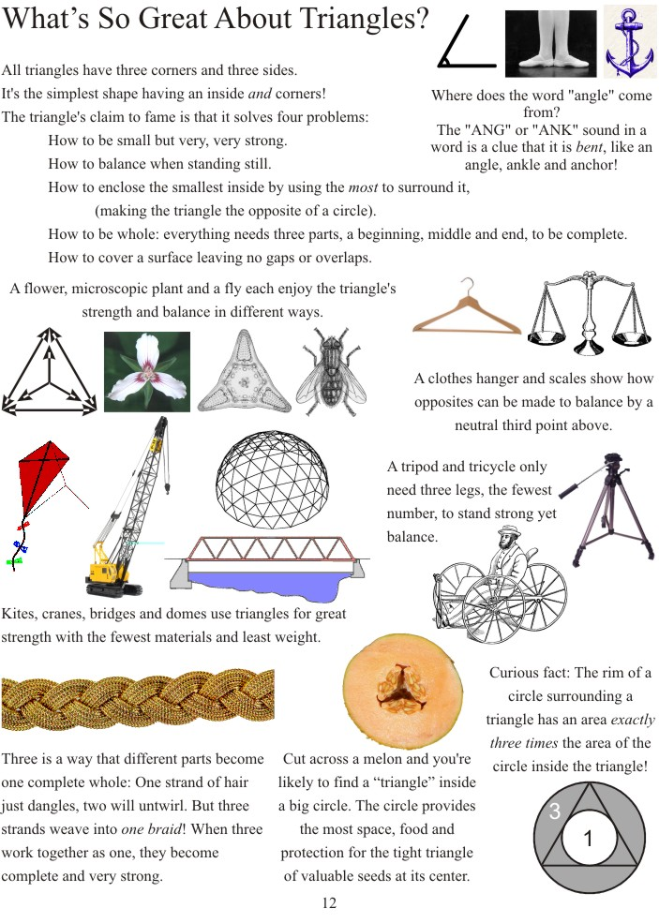
Page 28

Slide 8
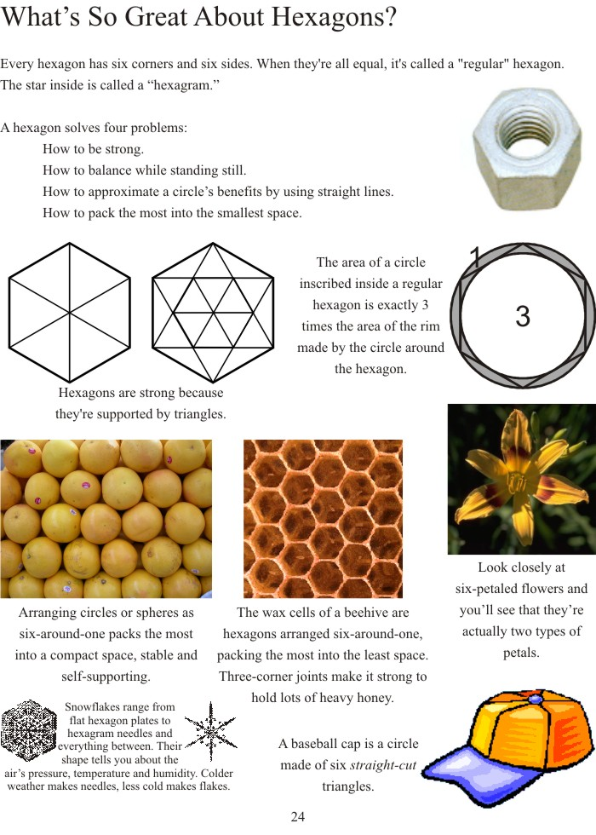
Page 29

Slide 9
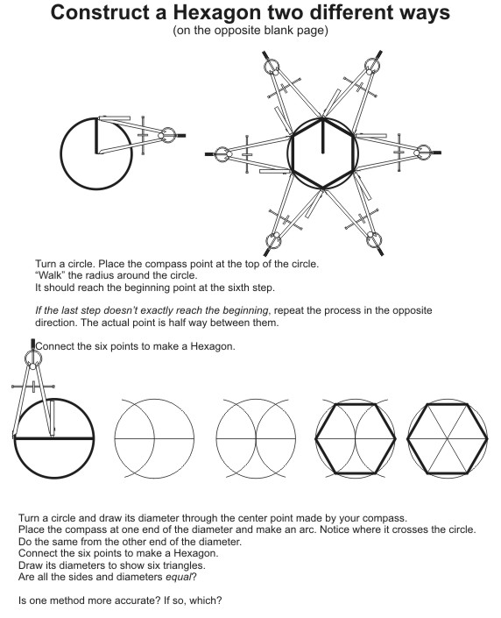
Page 31
1: “Walk” the radius around the circle (in both directions).
2: Draw a circle and diameter. Turn the compass around and make an arc from each end.

Slide 10
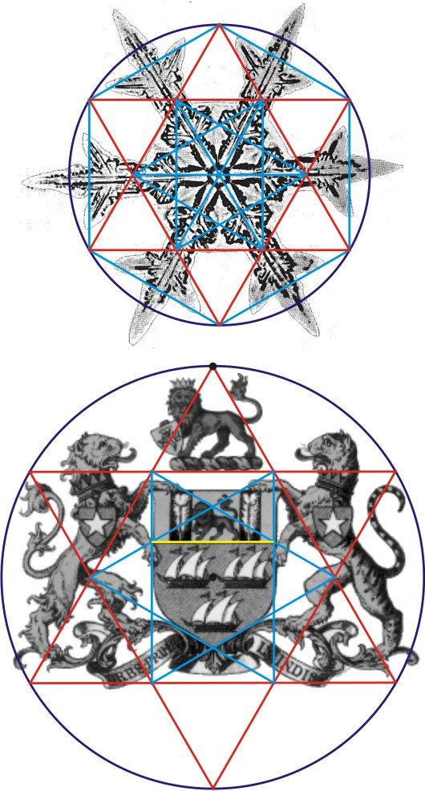

Slide 11
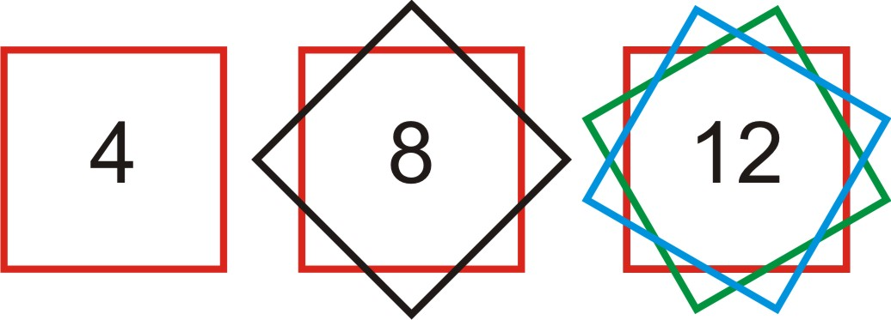
4 – 8 - 12
points
points
points

Slide 12
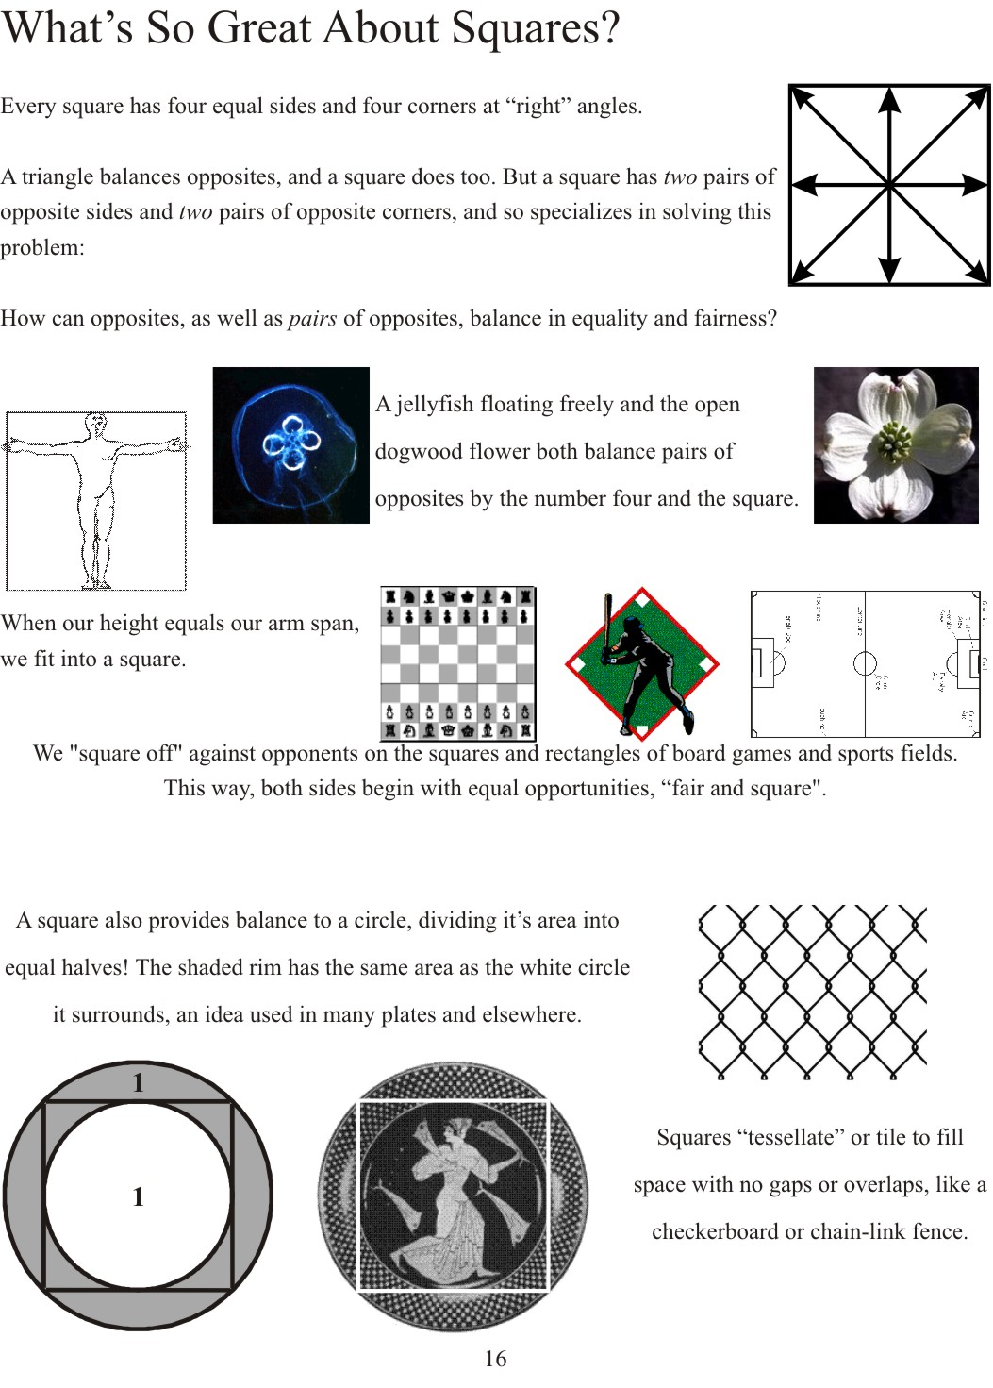
Page 40

Slide 13
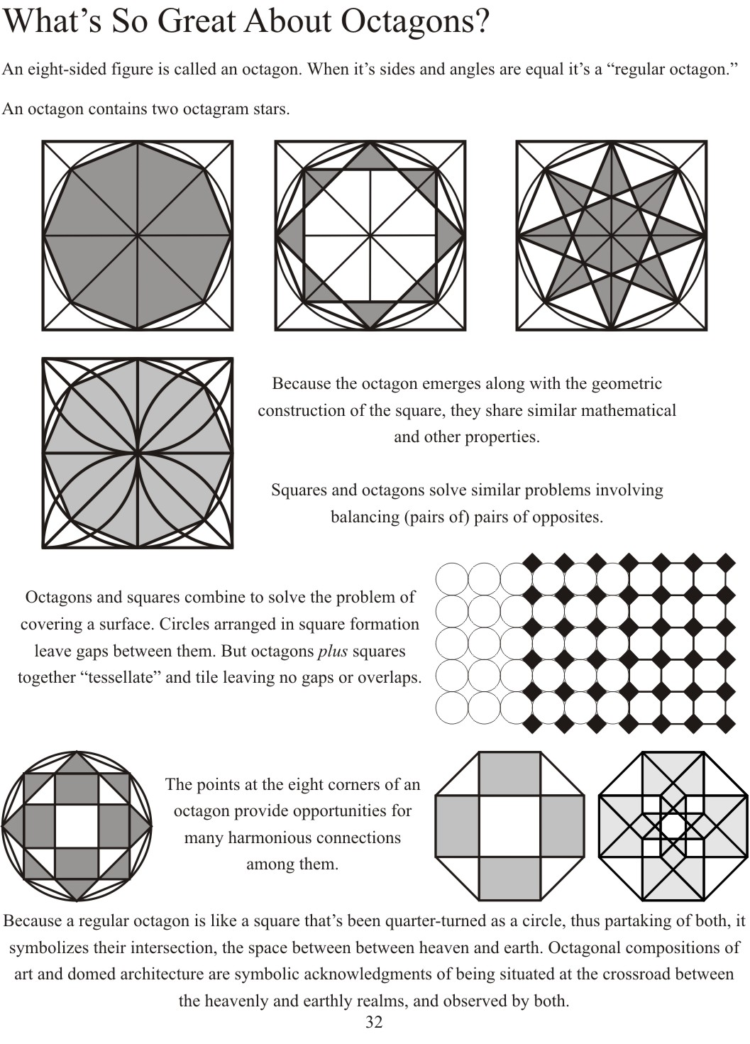
Page 50

Slide 14
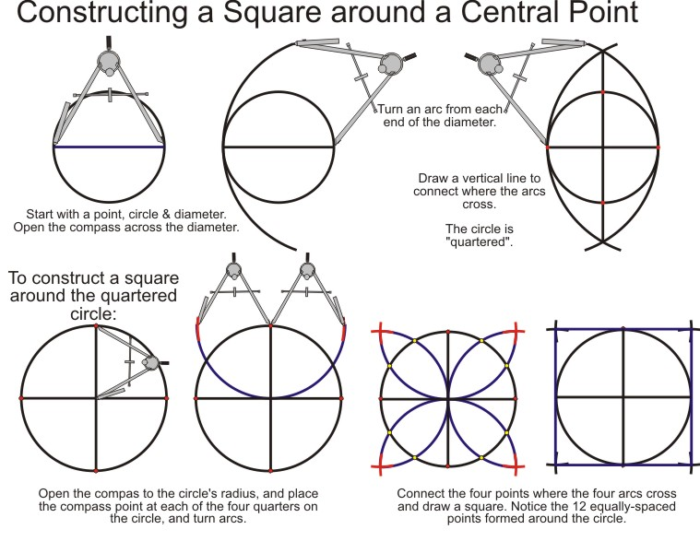
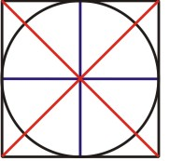
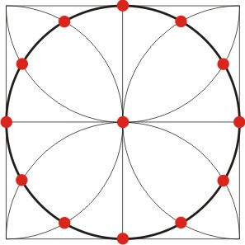
4 – 8 – 12 equally-spaced points around a circle can be found by
Page 41
“Almond”
4: Square
8 points around the circle:
Draw two diagonals
12 crossings

Slide 15
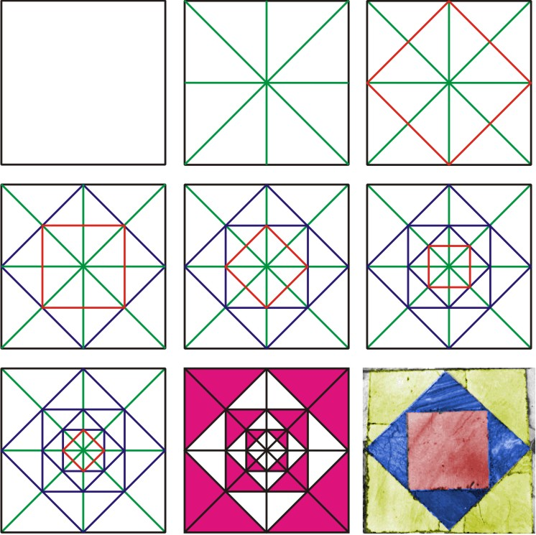
To Subdivide A Square draw its cross and diagonals
Page 42

Slide 16
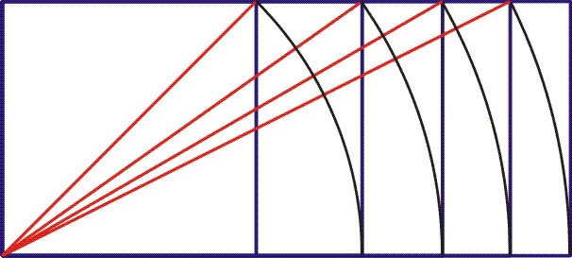
Page 57
Square-Root Rectangle Symmetry
= 1
= 1.414…
< 1.5
= 1.732…
< 1.75
= 2
= 2.236…
< 2.25

Slide 17
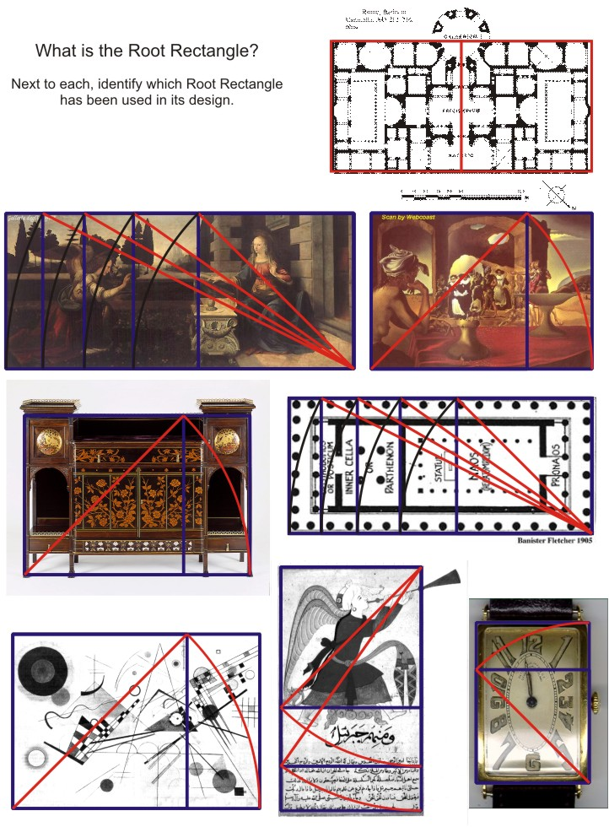
Page 60
Sqrt 4
Sqrt 5
Sqrt 2
Sqrt 2
Sqrt 5
Sqrt 3
Sqrt 2
Sqrt 2

Slide 18
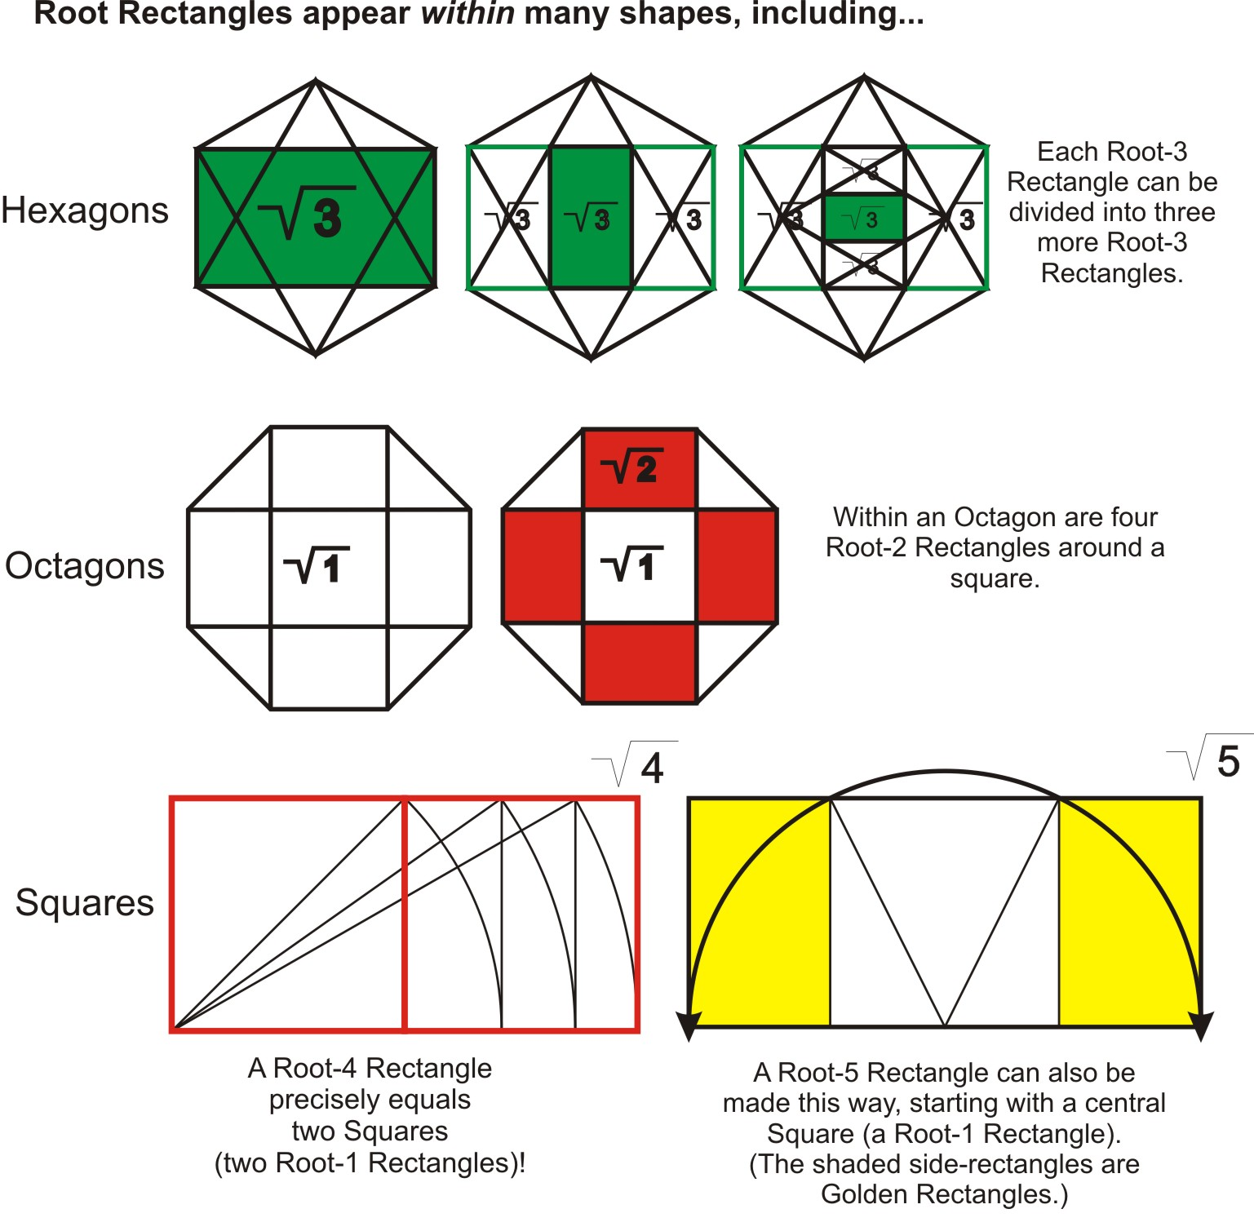
Page 59

Slide 19
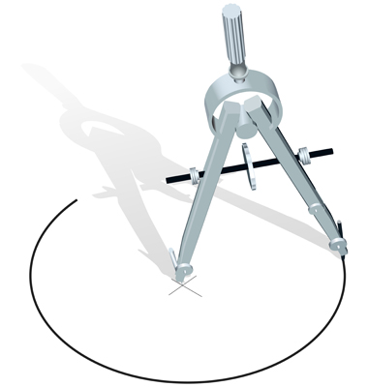
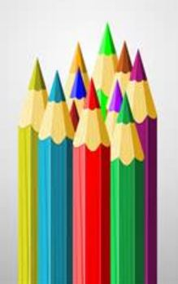
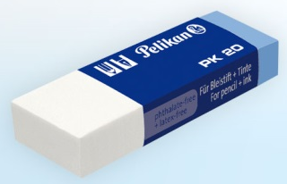
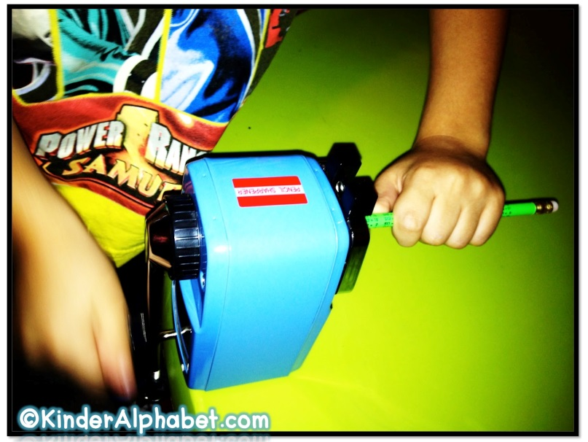
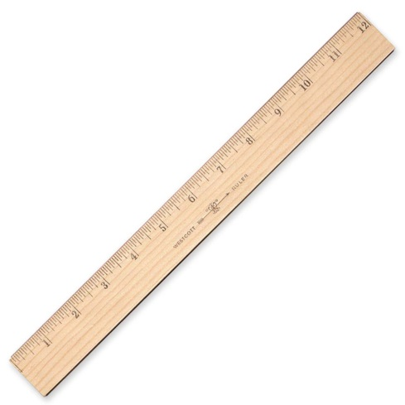

Slide 21
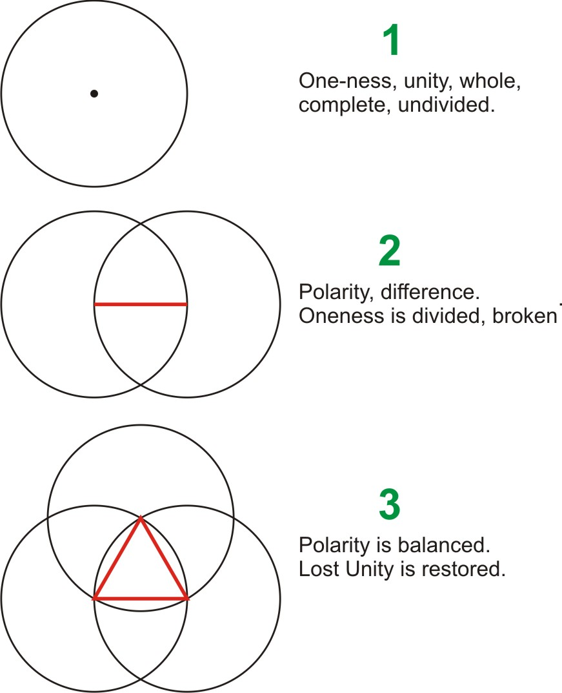
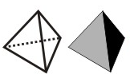
Cooperation or conflict?
Structure appears.
The third brings the opposites to a new level they couldn’t achieve by themselves.
4
Structure is clothed in matter, it materializes in 3 dimensions.

Slide 22
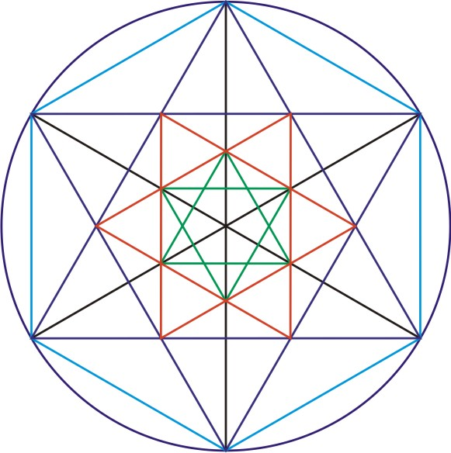
Be accurate!

